Slide 1
LU Decomposition: Solving
Large-Scale Linear
Systems in ML
Name: Shreyash Lal
University Roll: 13030824012
Paper Name: Maths
Paper Code: BSC301
Dept: CSE(AI & ML) - A
Sem: 3rd

Slide 2

What is LU Decomposition?
LU Decomposition is a fundamental matrix factorization technique that breaks down a square matrix A into the product of a lower triangular matrix L and an upper triangular matrix U.
This process simplifies complex linear systems by transforming them into a sequence of easier-to-solve triangular systems. It's essential for efficient computation in numerical linear algebra.

Slide 3
The Mathematical Concept
LU Decomposition expresses a matrix A as:
A: The original square matrix.
L: A lower triangular matrix with ones on the main diagonal.
U: An upper triangular matrix.
Step 2: Backward Substitution
Step 1: Forward Substitution
Solve Ux = y for x.
Solve Ly = b for y.
This two-step process replaces direct Ax = b solving, which can be computationally intensive.

Slide 4
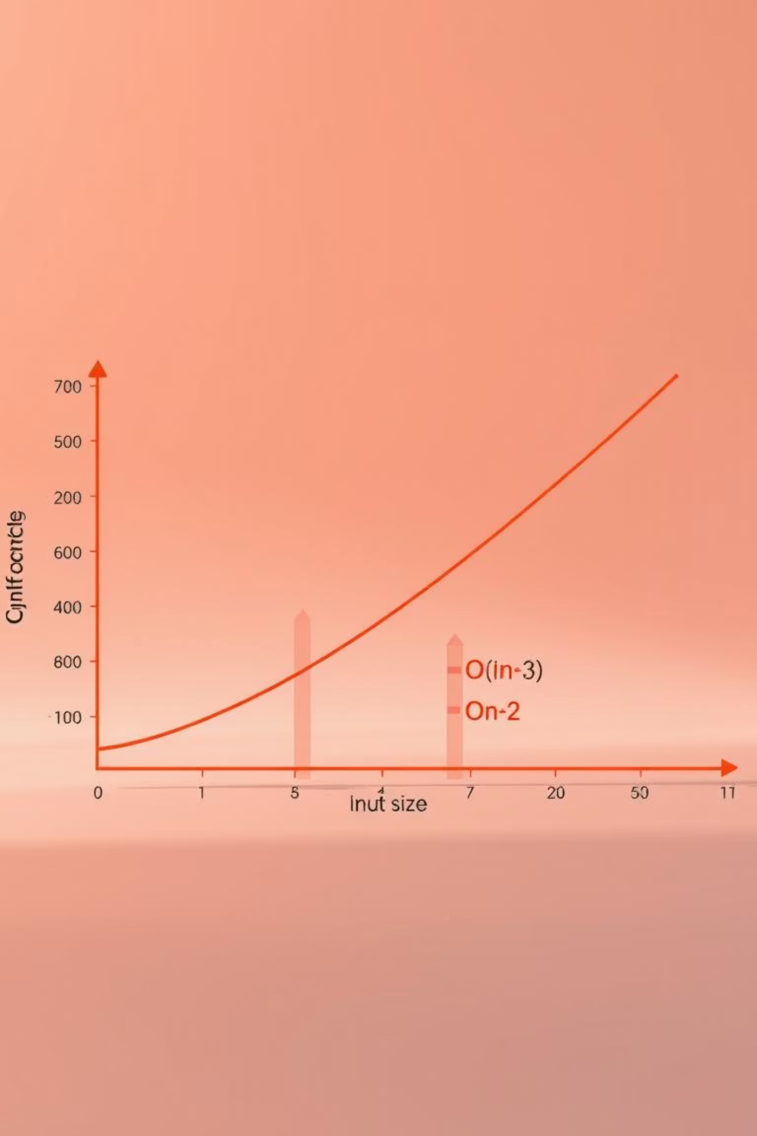
Computational Advantages
LU Decomposition offers significant efficiency for solving multiple linear systems with the same coefficient matrix.
Efficiency
1
Once A is decomposed, solving Ax=b for different b vectors is much faster, requiring O(n^2) operations instead of O(n^3).
Numerical Stability
2
Pivoting (row exchanges) can be incorporated to enhance numerical stability, especially when dealing with ill-conditioned matrices.
This makes it ideal for iterative algorithms where the system matrix remains constant.

Slide 5

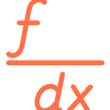


Application in Machine Learning
LU Decomposition is a cornerstone in various ML applications, particularly where large linear systems arise.
Optimization
Linear Regression
Used in Newton's method for solving non-linear optimization problems, crucial for training complex models.
Efficiently solves normal equations for finding optimal regression coefficients in large datasets.
Numerical Stability
Model Inversion
Enhances the robustness of algorithms handling large, sparse matrices common in deep learning and NLP.
Useful for computing inverses of Hessian matrices in second-order optimization algorithms.

Slide 6
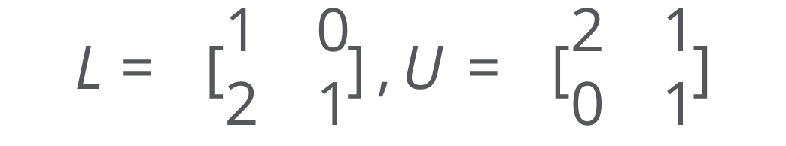
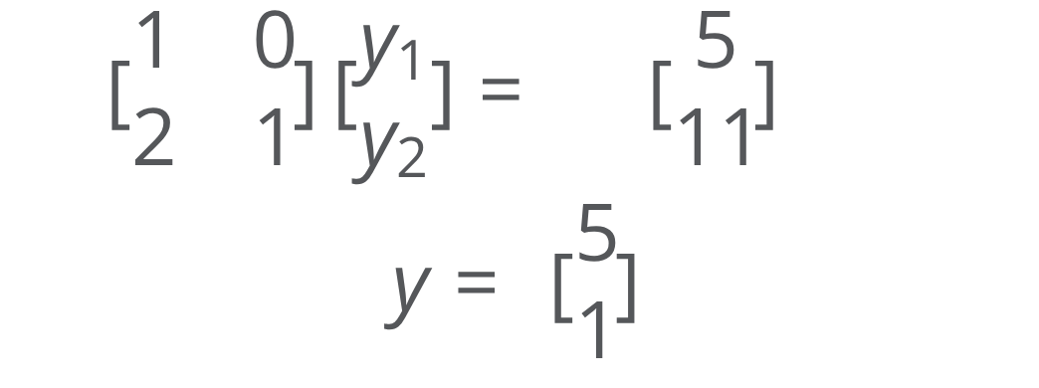
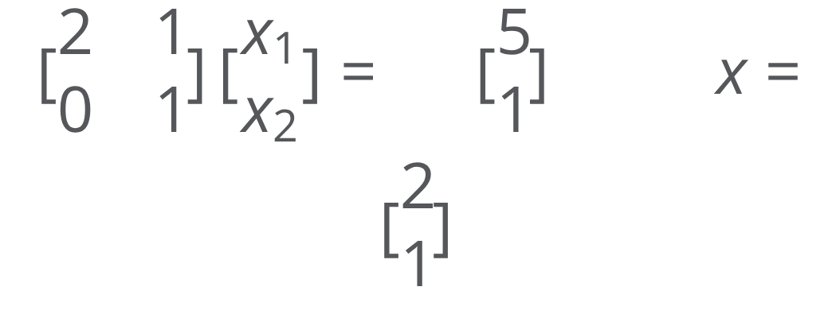
Case Study: Solving Ax = b
Consider the system:
Decomposition
Forward Substitution
Backward Substitution
A is decomposed into:
Solve Ly = b for y:
Solve Ux = y for x:

Slide 7

Conclusion & References
Key Takeaways
LU decomposition simplifies linear systems.
Offers significant computational efficiency for large-scale problems.
Crucial for optimization, regression, and numerical stability in ML.
Further Reading
Golub, G. H., & Van Loan, C. F. (2013). Matrix Computations (4th ed.). Johns Hopkins University Press.
Strang, G. (2016). Linear Algebra and Learning from Data. Wellesley-Cambridge Press.
Thank you!

